Slide 1
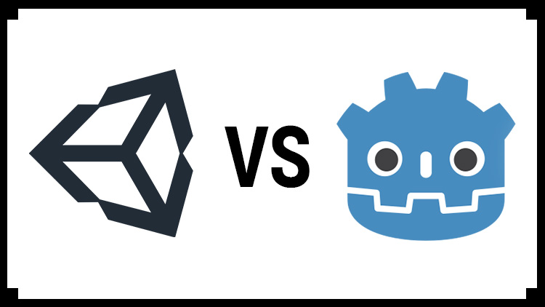
Comparative Analysis: Unity vs Godot - The Pros and Cons

Slide 2
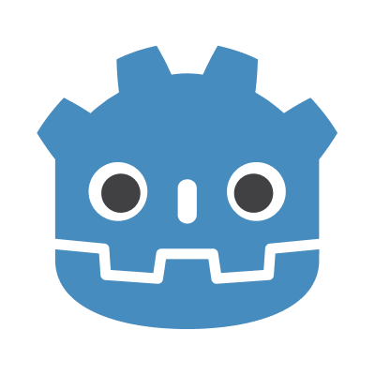
Introduction
In this presentation, we will explore the strengths and weaknesses of these two popular game development engines. By the end, you will have a clear understanding of which platform suits your needs best.
What are we going to look at;
History of Godot Engine
Differences Between Unity and Godot
Godot Examples

Slide 3
Inception (2007)
Godot Engine was created by Juan 'reduz' Linietsky, an experienced game developer, and several collaborators. It started as a side project while Linietsky was working on other game development tools. The engine was initially a closed-source project.
Open Sourcing (2014)
In 2014, the decision was made to open-source Godot under the MIT license. This move was pivotal in the engine's development, as it allowed a broader community of developers to contribute to its improvement.
Godot 1.0 (2014)
The first official release, Godot 1.0, marked the beginning of the engine's open-source journey. It featured a built-in script editor, scene system, and support for 2D and limited 3D graphics.
Godot 2.0 (2016)
The release of Godot 2.0 brought significant improvements, including a revamped animation system, 3D enhancements, and new features for game developers.

Slide 4
Godot 3.0 (2018)
Godot 3.0 was a major milestone in the engine's development. It introduced a brand-new 3D renderer, improved 2D capabilities, a new visual scripting system, and support for various platforms.
Godot 3.1 and 3.2 (2019-2020)
These releases focused on improving the engine's stability, performance, and usability. They introduced a wide range of new features and refinements.
Godot 3.2.3 (2021)
This version was notable for its enhanced HTML5 export capabilities, improved C# support, and many other improvements and bug fixes.
Godot 4.0 (Ongoing)
Godot 4.0 is a highly anticipated major update that aims to bring significant improvements to the engine's 2D and 3D capabilities, graphics rendering, and overall performance.

Slide 5
Differences
Godot
Unity
Programming Language:
Godot primarily uses its scripting language called GDScript, which is similar to Python. It also supports C#, VisualScript (a node-based visual scripting language), and C++.
Editor and User Interface:
Godot's editor is known for its simplicity and ease of use. It has a clean and customizable interface that allows for a straightforward learning curve.
Programming Language:
Unity primarily uses C#. While it also supports JavaScript and Boo (a Python-like language), C# is the most commonly used language.
Editor and User Interface:
Unity has a more extensive and complex editor. It offers a wide range of features, but it can be overwhelming for beginners.

Slide 6
Differences
Godot
Unity
2D vs. 3D:
While Godot can handle both 2D and 3D game development, it is particularly renowned for its 2D capabilities. It provides powerful tools for 2D game creation, making it a great choice for 2D game developers.
Physics Engine:
Godot uses a custom physics engine. It's capable and designed for 2D and 3D physics, but it may not be as performance-optimized as Unity's physics system.
2D vs. 3D:
Unity is known for its strong support for 3D game development and provides extensive features for creating 3D games, including advanced rendering and physics systems.
Physics Engine:
Unity uses NVIDIA PhysX for its physics engine, offering robust and well-established 2D and 3D physics simulation.

Slide 7
Differences
Godot
Unity
Asset Store:
Godot has a smaller and less centralized asset store compared to Unity. Users often find and share assets through forums, but it lacks the extensive marketplace that Unity provides.
Platform Support:
Godot supports exporting to multiple platforms, including Windows, macOS, Linux, Android, iOS, HTML5, and more. However, it may have less robust support for certain platforms compared to Unity.
Asset Store:
Unity's Asset Store is a vast marketplace with a wide range of assets, plugins, and extensions that can speed up development and provide various resources for game developers.
Platform Support:
Unity is known for its broad platform support, including consoles like Xbox and PlayStation, in addition to various desktop and mobile platforms.

Slide 8
Differences
Godot
Unity
Pricing and Licensing:
Godot is open-source and released under the MIT license. This means it's entirely free to use, even for commercial purposes, and you can modify the source code.
Community and Ecosystem:
Godot's community is growing but smaller compared to Unity's. However, it has a passionate and active user base.
Pricing and Licensing:
Unity offers both a free Personal Edition and a paid Professional Edition. The free version has some feature limitations, and the Pro version requires a subscription. Unity has tiered pricing plans based on features and revenue thresholds.
Community and Ecosystem:
Unity has a massive and well-established community, which can be beneficial for finding help, tutorials, and resources.

Slide 9
Differences
Godot
Unity
Performance:
Godot is known for its efficient 2D rendering, but performance can vary in 3D, especially for complex and graphically demanding games.
Performance:
Unity provides strong performance for 3D games, with optimizations for various platforms. However, performance can be affected by poorly optimized code or assets.

Slide 10
Summary
In summary, the choice between Godot and Unity depends on your specific project requirements, familiarity with programming languages, and the complexity of the game you're developing. Godot is an excellent choice for 2D games and those who prefer an open-source, easy-to-learn engine. Unity, on the other hand, is well-suited for 3D games, and it offers a vast ecosystem of assets and a wide range of platform support.
A list of games made with Godot in 2022
Lumencraft
The Ballad of Bonky
The Cassette Beasts
Pingo Adventure
Fist of the Forgotten
Friday Night Funkin
Voxurbis: Age of Politicians
Project Heartbeat
Gawr Gura: Quest for Bread
Halls of Torment
White Yarn
Quetzal
Takara Cards
Virtual Circuit Board
The Legend of Lumina
Demise Sanctuary
Dashpong
Of Blades & Tails
Extinction Eclipse
Cardbob: Revival
Swords and Sandals Immortals
ROTA
WHATEVER
Paper Lily
ProtoCorgi
Brotato
Dome Keeper

Slide 11
A Showcase of What Has Been Made With Godot Engine in 2022
Thank you
Desktop Games here
Mobile Games here
Apps and Tools here

